Slide 1
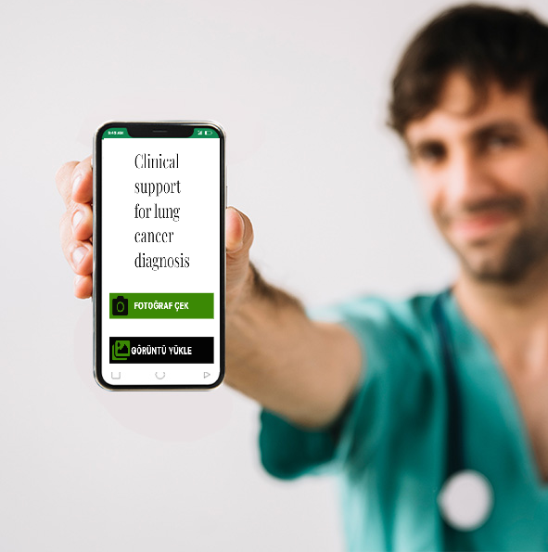

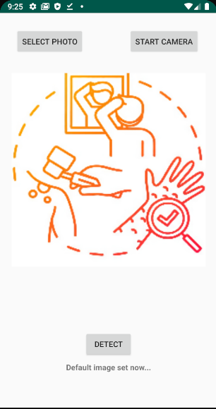
Clinical Support Mobile Application Development for Histopathology Images of Lung Cancer
Metin eklemek için tıklayın
Senior Design Project 2021-2022
Emre Taşkın

Slide 2
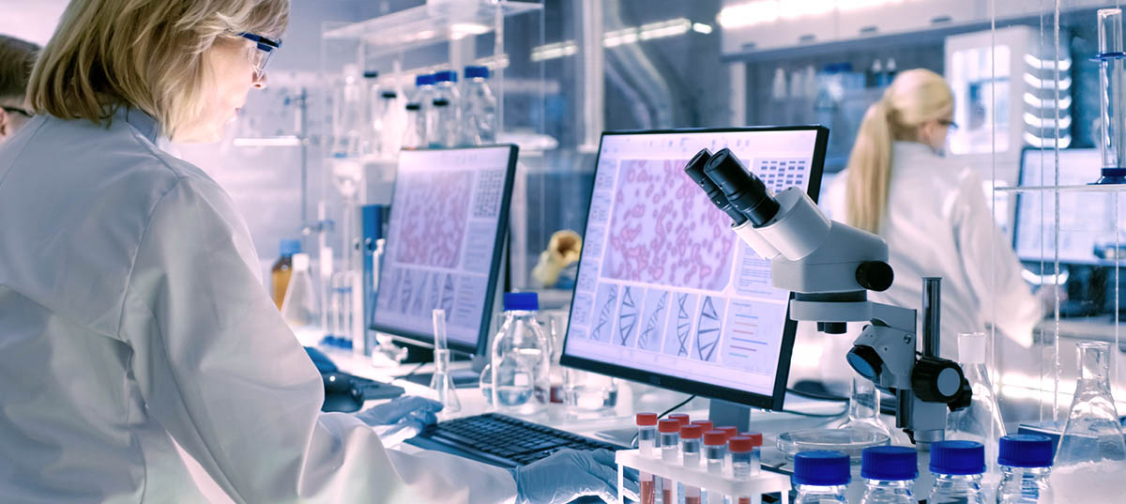
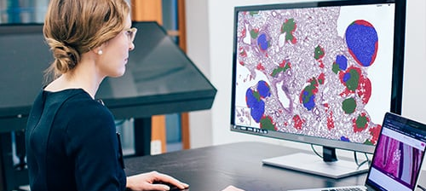
Goal-Motivation
Developing a mobile application to assist pathologists in diagnosing lung cancer.

Slide 3

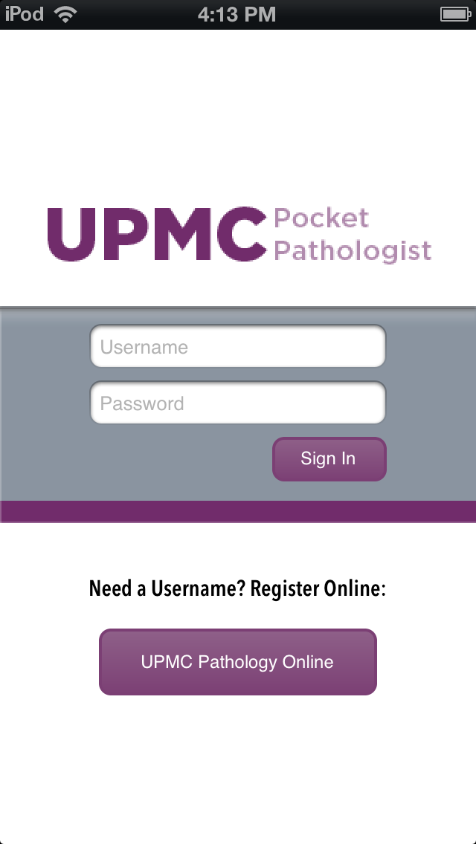
Market Analysis

Slide 4
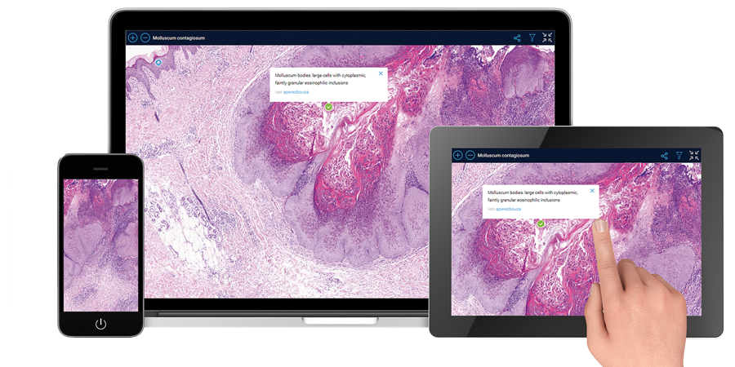
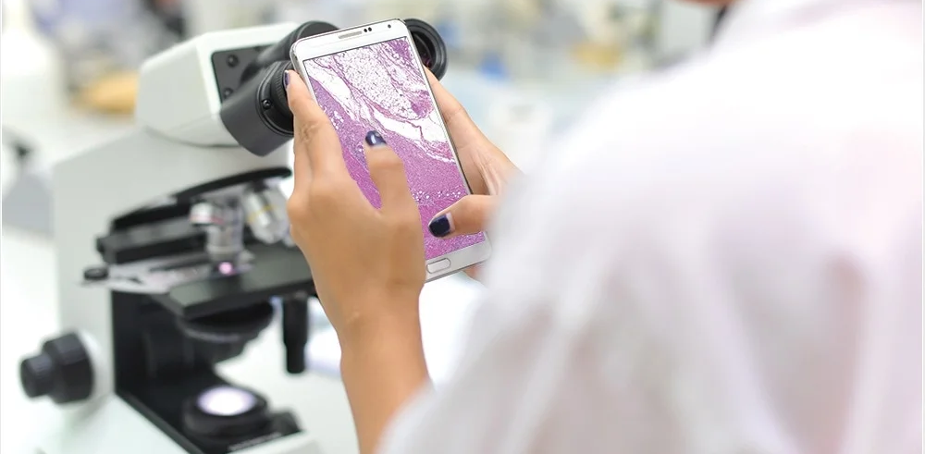
Benefits
Can be carried in pocket
Easy to access and use
Beneficial for human health.

Slide 5



First semester
Data prepared
TUBITAK 2209-A
I created the environment for development
I created the prototype of the mobile app
Second semester TUBITAK 2242 was also applied

Slide 6

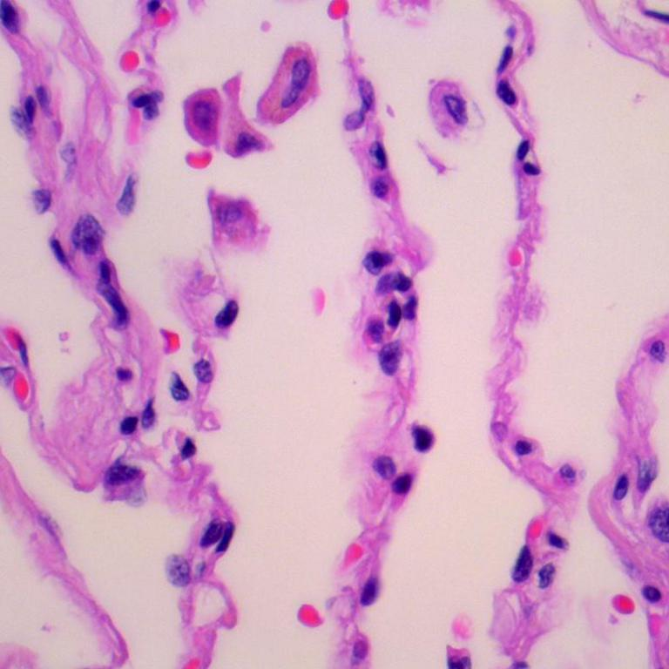
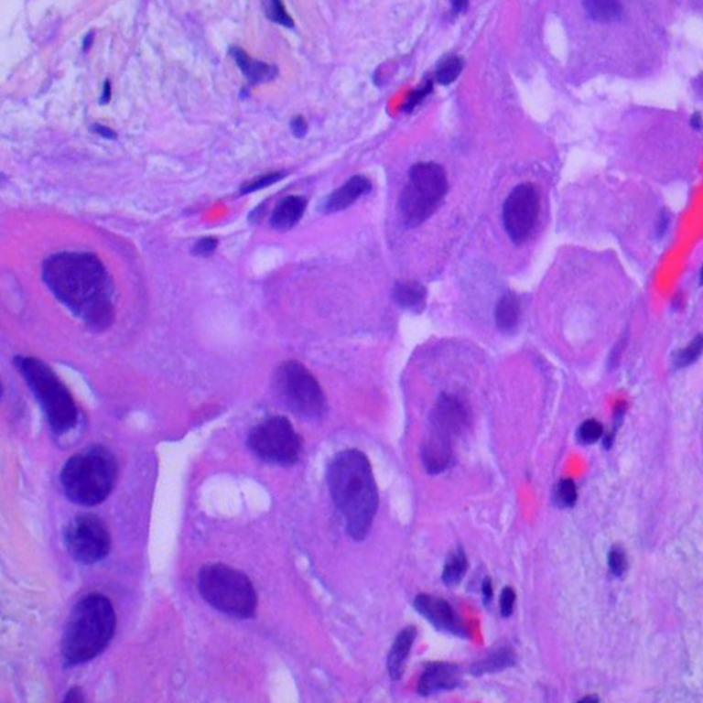
Data
The data was downloaded from the kaggle as 10,000 malignant and 5,000 benign images.

Slide 7
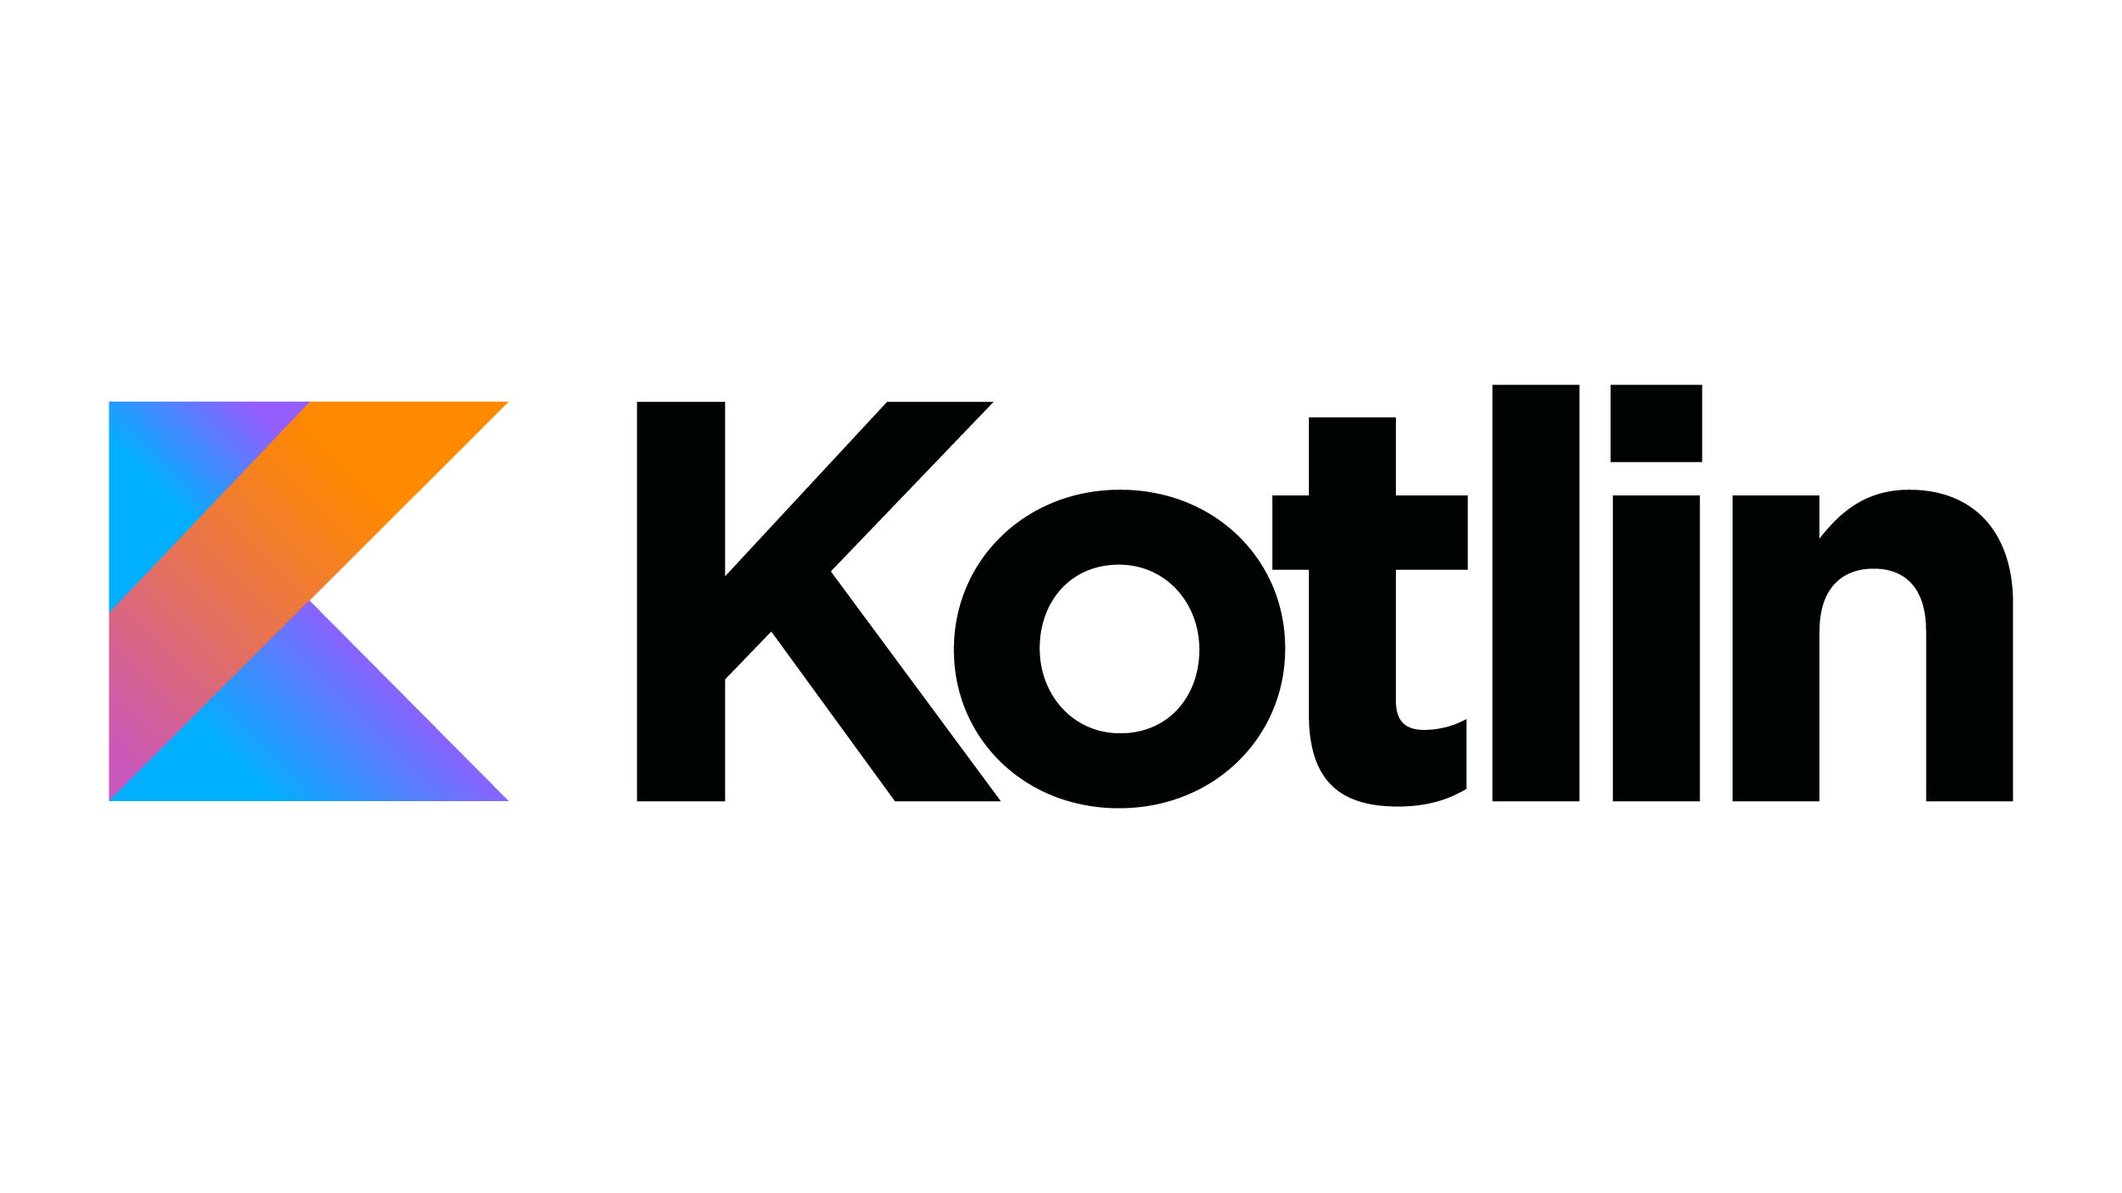

Android App Part
Mobile application was developed in the android studio environment using the kotlin language.

Slide 8
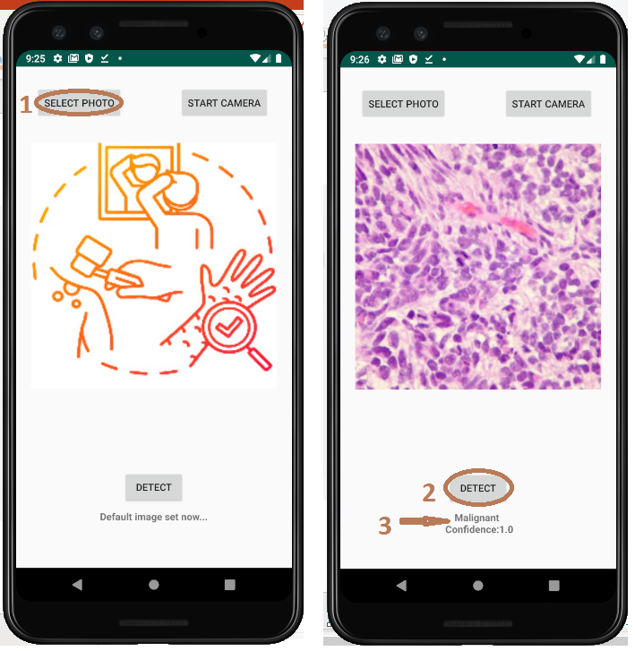
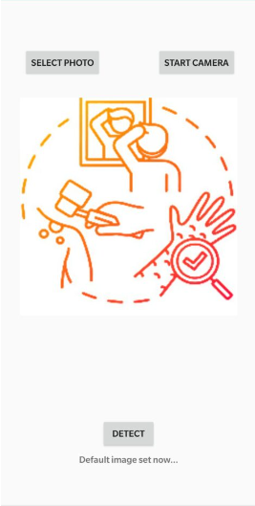
Mobile App Interface

Slide 9

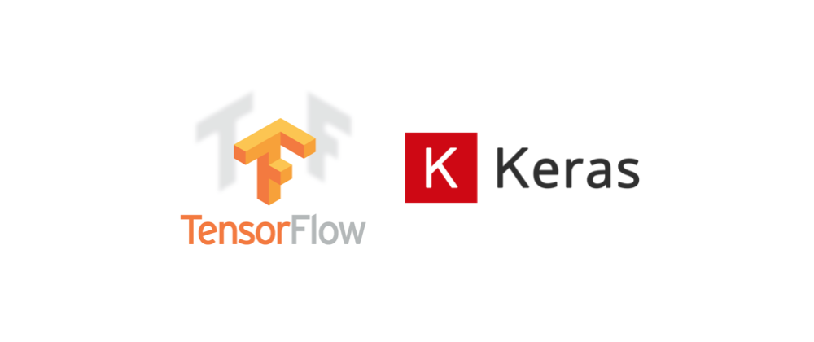
Building Model
TensorFlow and Keras are used to build and create a machine learning model.
TFLite is used to deploy the model to an Android application.

Slide 10

Tensorflow with Keras Deep Learning model
Using Convolutional Neural Networks, I developed algorithms and models to distinguish between benign and malignant lung cancers. For source code editing, I utilise Colab.

Slide 11
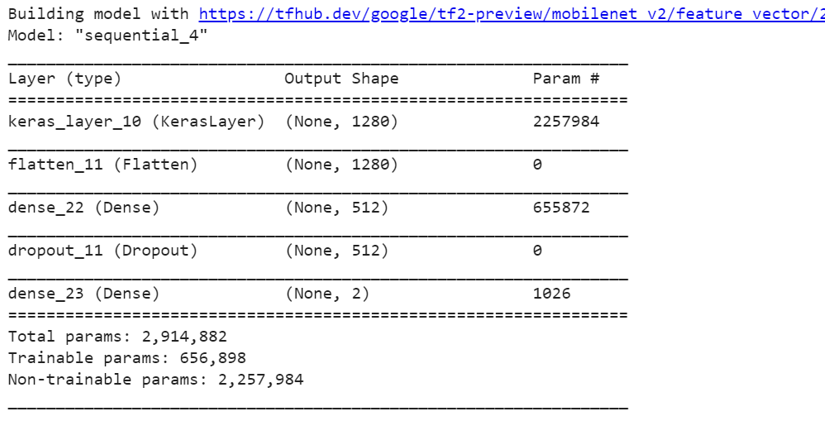
Model Information
To use the Tensorflow hub module, the model can be trained with the inception v3 or Mobilenet options. I used the MobileNet model.

Slide 12
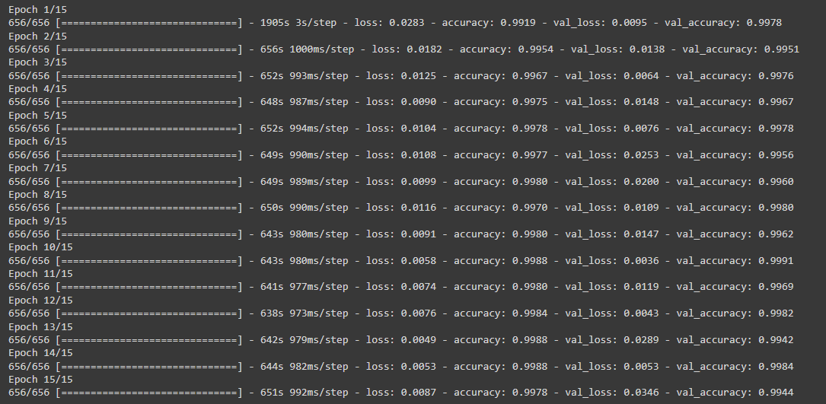
Training Model
Validate each step by training the model with the validation dataset. I achieve 99% accuracy after 15 epochs

Slide 13
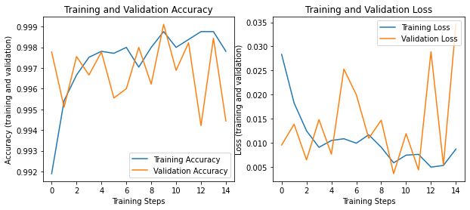
Graph Results

Slide 14
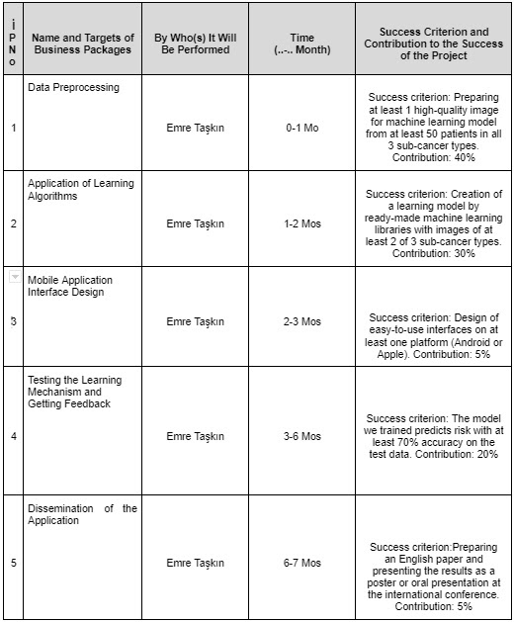
Timeline

Slide 15
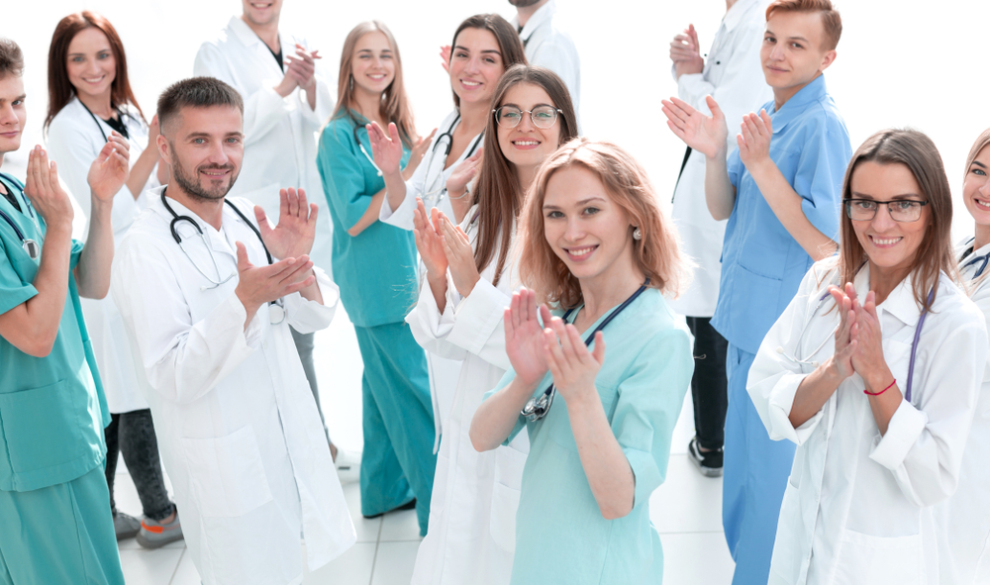
Thank you for listening!
emretaskn57@gmail.com

